Slide 1
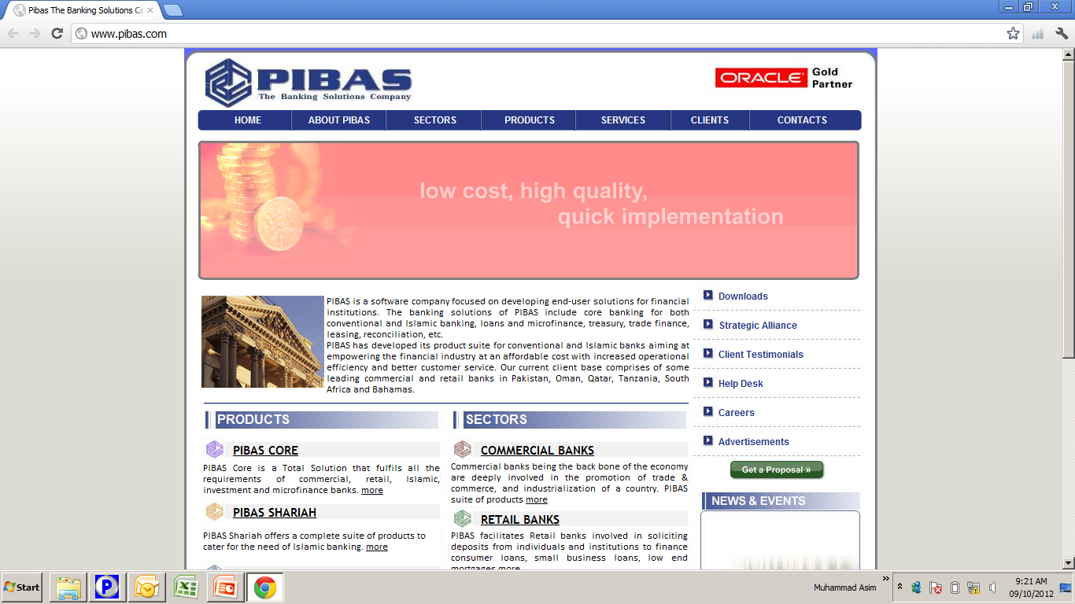
End of Day & Start of Day
End of Day & Start of Day
Important Note:
SME Data (as on 23-02-2012) and SME Bin will be used for this training.

Slide 2
Contents
End of Day & Start of Day
What is “End of Day Processing”
Precautions before End of Day Processing
Backup Procedures before End of Day Processing
End of Day Verifier
Possible error (s) handling of End of Day Verifier
End of Day Processing
End of Day Reports
Backup Procedures after End of Day Processing
==========================================================
What is “Start of Day Processing”
Precautions before Start of Day Processing
Start of Day Processing

Slide 3
What is “End of Day Processing”
End of Day & Start of Day
Important Points
End of the Day Processing could be defined as “Closure of Books of an Institution at a Point of Time, to check / verify / distinguish / compare / save the Financial Results / Records of that point of time with the Financial Results / Records of some other point of time of same institution or subsidiary / branch of this institution or some other institution” . For example if End of the Day Processing of an institution is executed on February 23, 2012 and another End of the Day Processing is executed on February 24, 2012 so one can check the both positions separately and comparatively as well. This also distinguish one day’s activities from other day’s activities.

Slide 4
Precautions before End of Day Processing
End of Day & Start of Day
Important Points
All activities of every department should be stopped / completed in system
No one should be log into the system except the administrator or end of the day executor
All activities should be supervised and no un-supervised record should be available
Backup should be taken and should be saved to some other systems / servers as well. If the same is stored some other external resources i.e. CD, USB, DVD, Dat Drive or some other reliable resources
Verification of backup
End of Day Verifier Execution – this option informs us any irregularity (ies).
Bin should be updated

Slide 5
Backup Procedures before End of Day Processing
End of Day & Start of Day
Important Points
BACKUP IS MUST and after backing up, the backup file should be loaded to some other mock system / server to verify the authenticity of the backup you have taken
Backup should be taken and should be saved to some other systems / servers as well. It is also strongly recommended that the same is stored on some other external resources i.e. CD, USB, DVD, Dat Drive or some other reliable resources
Backup Procedures may vary from bank to bank and different utilities are used. Here you will use Export Import Utility that takes backup on a specified location.

Slide 6
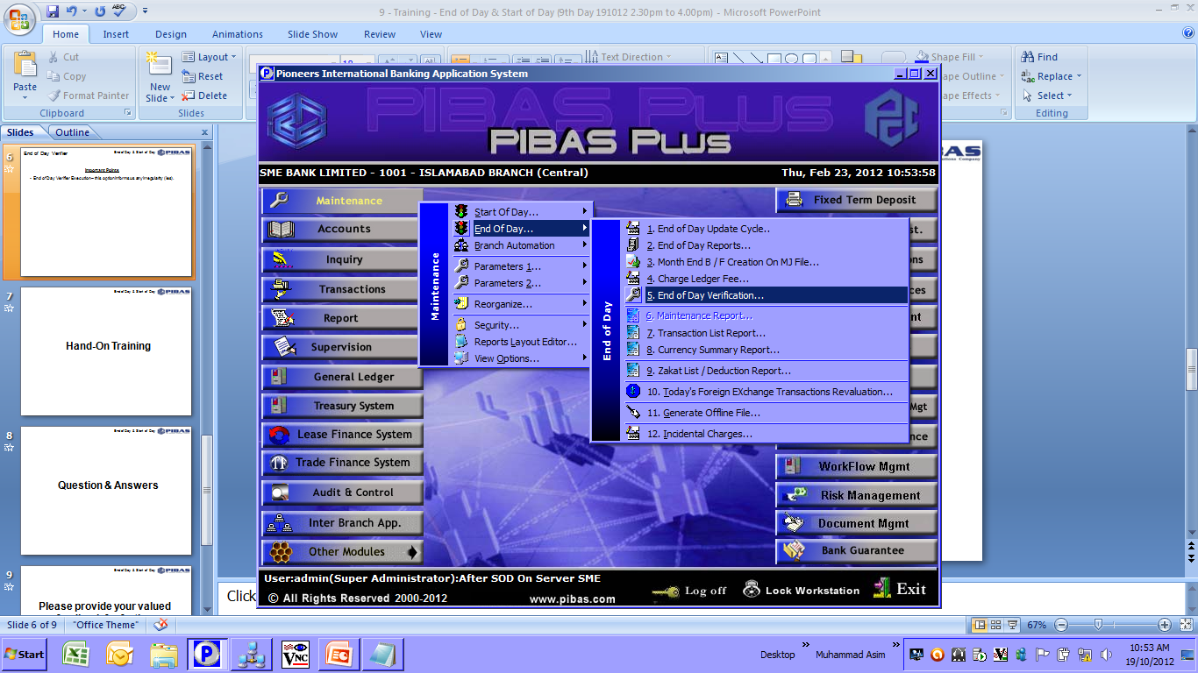
End of Day Verifier
End of Day & Start of Day
Important Points
End of Day Verifier Execution – this option informs us any irregularity (ies).
This option saves the administrator to avoid data loss during end of the day and unnecessary restoring of backup that takes a lot of time

Slide 7
Possible error (s) handling of End of Day Verifier
End of Day & Start of Day
Important Points
Bin is not updated or some other bank’s bin is being used
Transactions not balanced (debit and credit are not equal)
Any un-supervised transaction (s) found
Any flag of PSC, LMF, PTS, IBA or some other product is not marked. For this we will change the flag by accessing the table directly. In normal scenario it is not recommended and our clients will use some other proper options to change the flags.

Slide 8
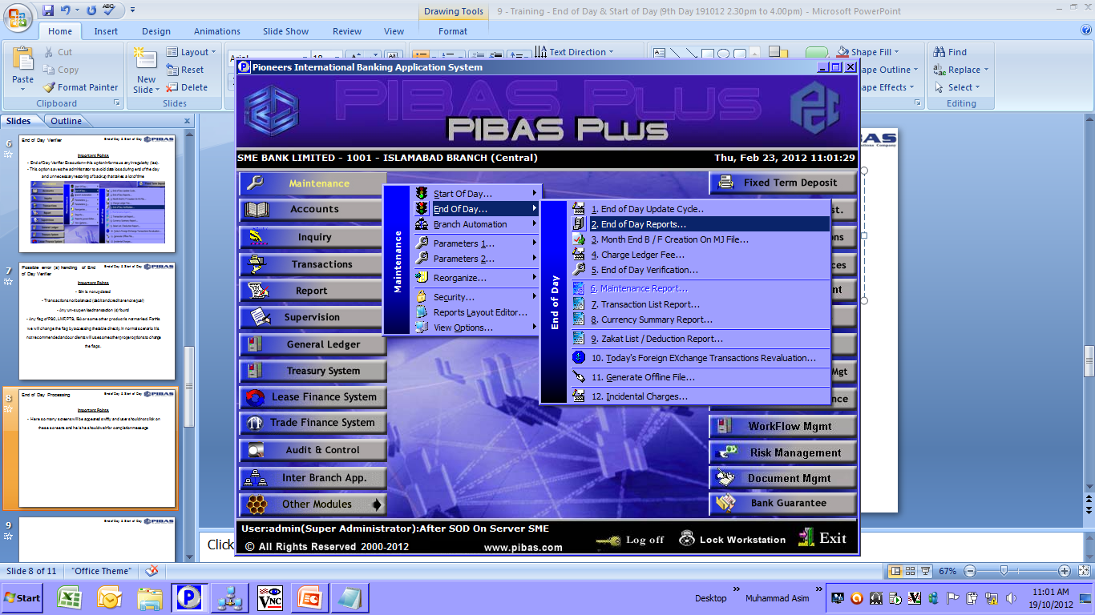
End of Day Processing
End of Day & Start of Day
Important Points
Here so many screens will be appeared swiftly and user should not click on these screens and he / she should wait for the completion message

Slide 9
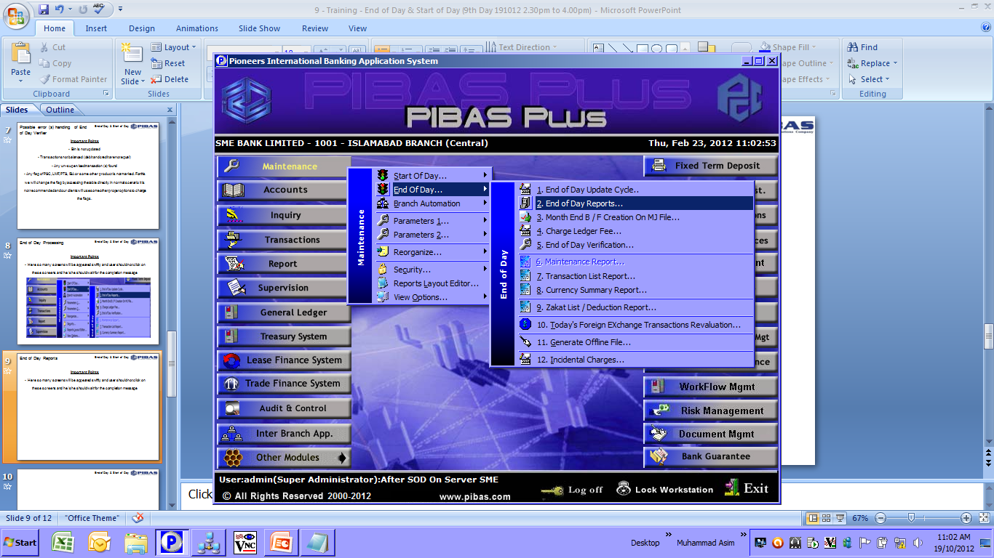
End of Day Reports
End of Day & Start of Day
Important Points
Here so many screens will be appeared swiftly and user should not click on these screens and he / she should wait for the completion message

Slide 10
Backup Procedures after End of Day Processing
End of Day & Start of Day
Important Points
BACKUP IS MUST and after backing up, the backup file should be loaded to some other mock system / server to verify the authenticity of the backup you have taken
Backup should be taken and should be saved to some other systems / servers as well. It is also strongly recommended that the same is stored on some other external resources i.e. CD, USB, DVD, Dat Drive or some other reliable resources
Backup Procedures may vary from bank to bank and different utilities are used. Here you will use Export Import Utility that takes backup on a specified location.

Slide 11
What is “Start of Day Processing”
End of Day & Start of Day
Important Points
After End of the Day Processing and Backing up of data, this option is used to INITIALIZED THE DAY for the execution of business activities into system.

Slide 12
Precautions before Start of Day Processing
End of Day & Start of Day
Important Points
No one should be log on to the system except the administrator / start of the day executor

Slide 13
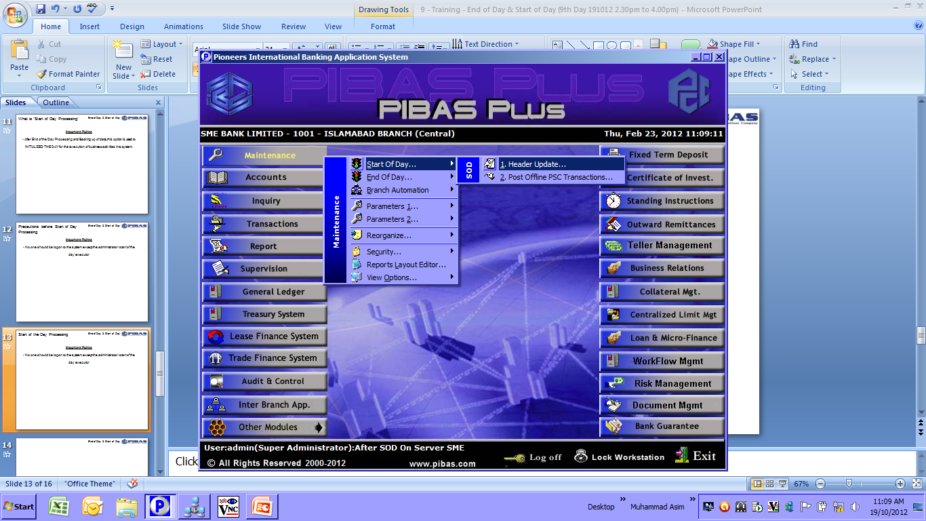
Start of the Day Processing
End of Day & Start of Day
Important Points
Correct input of Dates in this option is very important and crucial option and extra care should be given while punching the dates in system.

Slide 14
End of Day & Start of Day
Hand-On Training

Slide 15
End of Day & Start of Day
Question & Answers

Slide 16
End of Day & Start of Day
Please provide your valued feedback for further improvement of System and Training. Thanks for your active participation

